Slide 1
Consumer Market Segmentation
Presented By: Mahnoor Kashif

Slide 2
Introduction to Market Segmentation
Definition: Dividing a broad number of consumers or business markets into sub-groups of consumers based on shared characteristics.

Slide 3
Why Segment the Market?
Identify distinct customer needs
Better allocation of resources
Higher conversion rates
Optimize Marketing spend

Slide 4
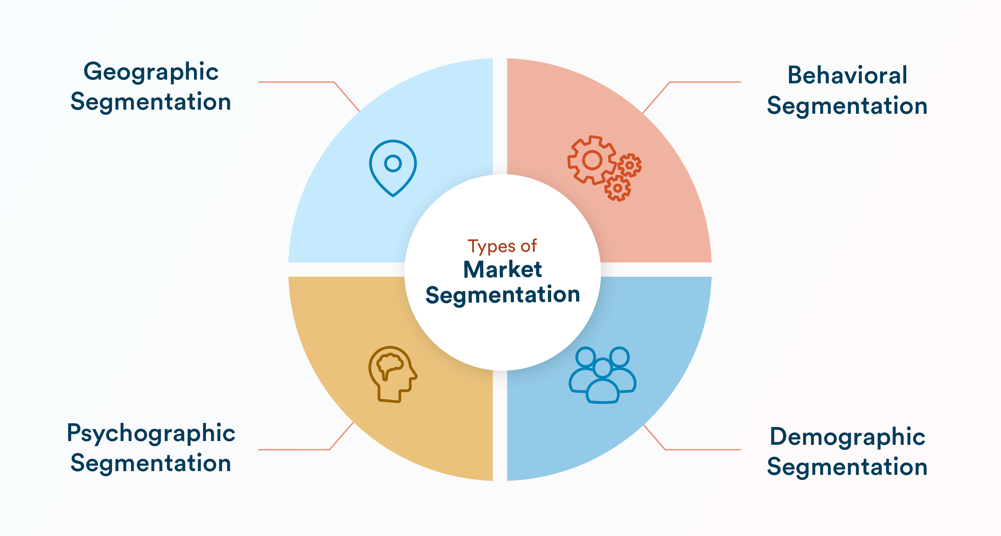
Types of Market Segmentation

Slide 5
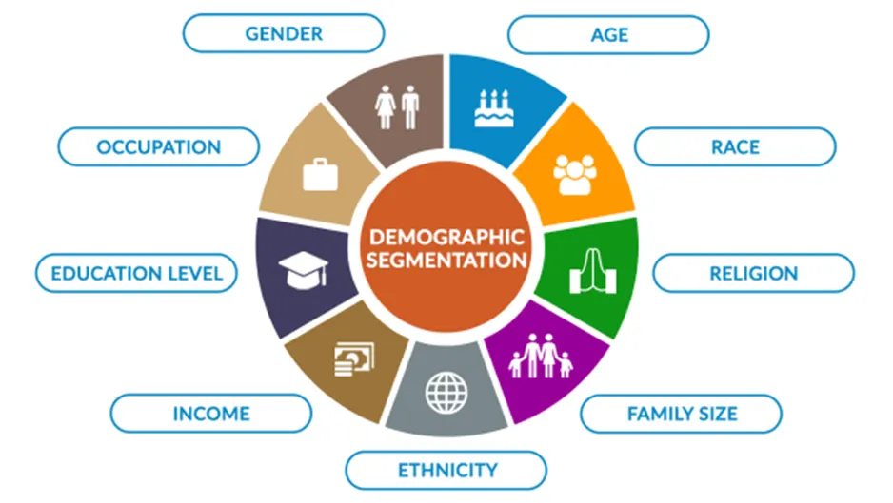
Demographic Segmentation
Based on measurable statistics:
Age
Gender
Income
Education
Family size
Example: Luxury brands targeting high-income individuals

Slide 6
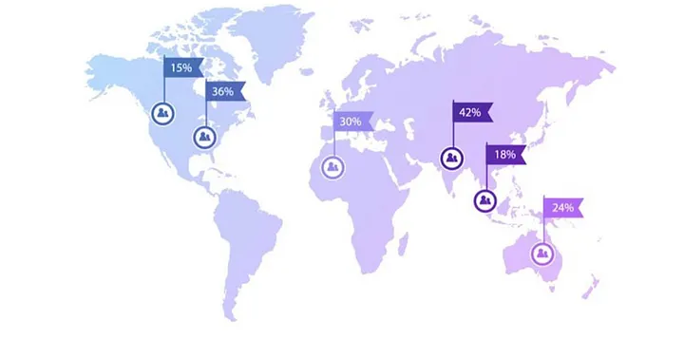
Geographic Segmentation
City
Country
Climate
Urban/ Rural
Example: McDonald’s adapts it’s menu according to local taste, culture and dietary restrictions
Middle East: Halal certified meat in all products

Slide 7
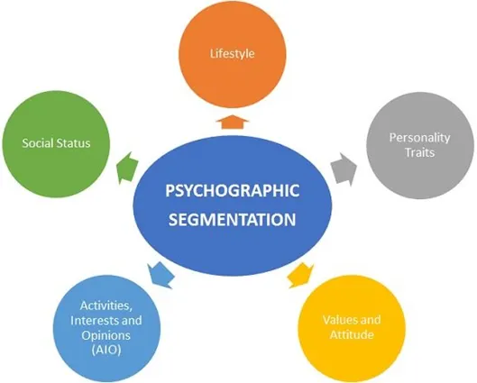
Psychographic Segmentation
Lifestyle
Social Status
Personality Traits
Values
Example: IKEA targets budget friendly, conscious people who value designs

Slide 8
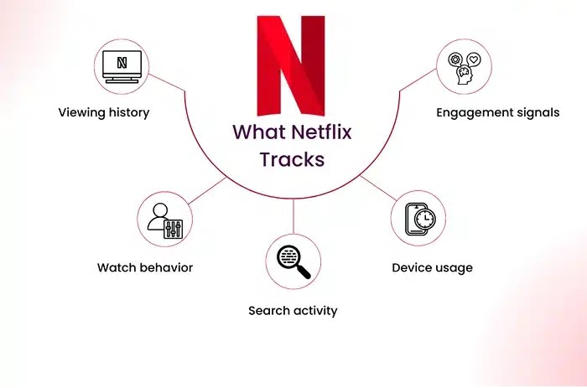
Behavioral Segmentation
Purchase habits
Brand loyalty
Usage rates
Benefit needed
Example: Netflix uses viewing history and content preferences to recommend movies and shows

